Slide 1

GitHub User Analysis
Xin Guan | Ziqian Ge

Slide 2
About GitHub
a web-based hosting service of version control using Git. (Wikipedia)
The world's largest community of developers to discover.
31 million users (October 2018)
100 million repositories (November 2018)
Notes:
According to Evans Data Corporation(EDC) there are about 23 million developers worldwide. So we believe Github is a good representation of United States even world developers.
https://www.c-sharpcorner.com/article/how-many-software-developers-are-there-in-the-world/

Slide 3
Goal of Project
Who are those developers
Trends among developers

Slide 4
Content of the Project
Data Collection
Data Cleaning
User Analysis
Repository Analysis
Prediction

Slide 5
Data Collection
GitHub API
Third party data from GHTorrent

Slide 6
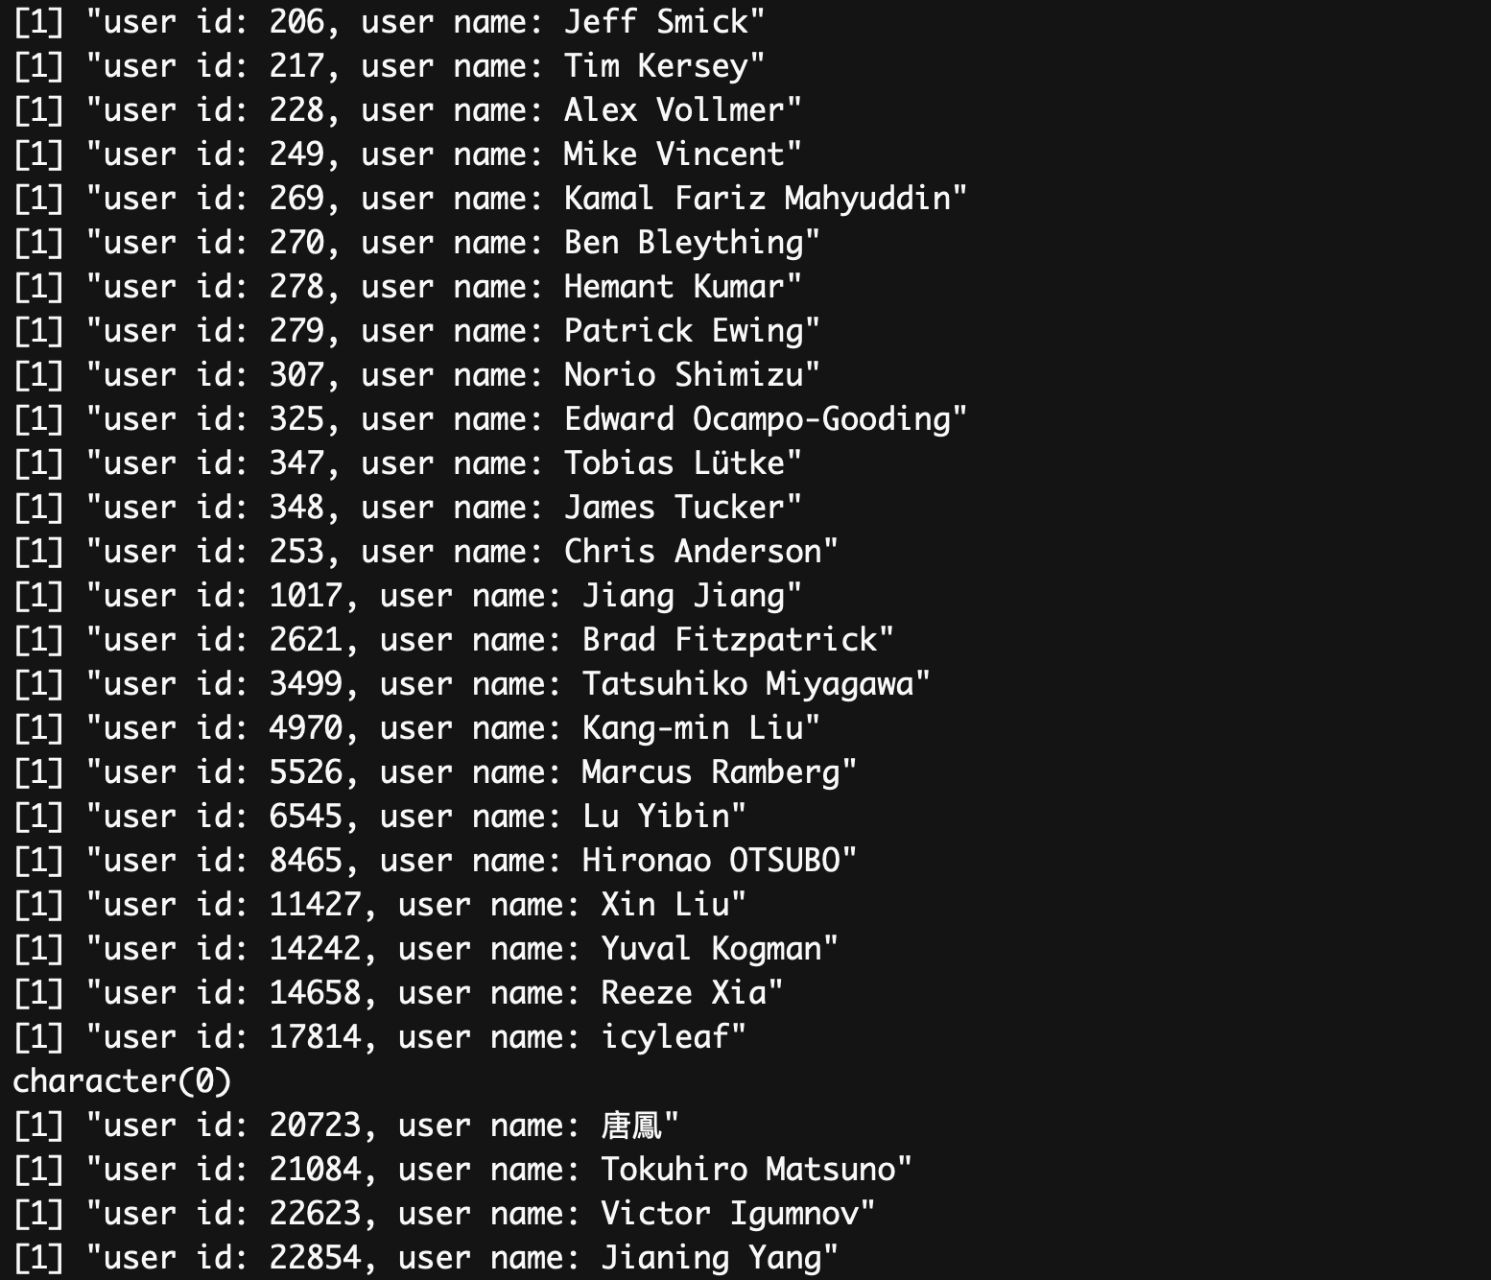

Slide 7
Difficulty
Large amount of data
restricted access to API (5000 per hour)
Not in the form of relational data base
Uncleaned Data

Slide 8
Data Cleaning
Ignore users with 0 repositories, 0 followers and 0 following
Ignore users without self-description (no location, company or bio)
Ignore repos with 0 stars, 0 forks, 0 open issues, or 0 subscibers
Remove NA
Outliers

Slide 9
User Analysis
Where?
Selecting Users with location data
Clean users’ information with Regex
Count, Sort, Plot

Slide 10
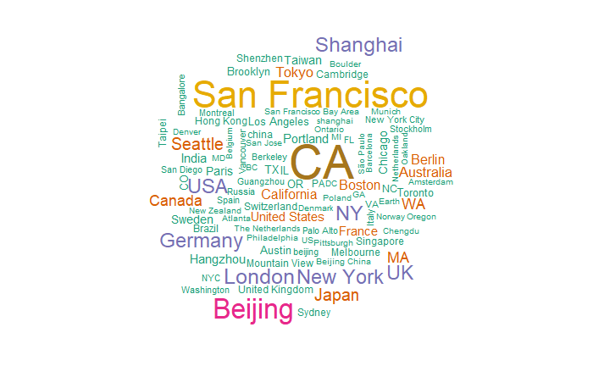

Slide 11
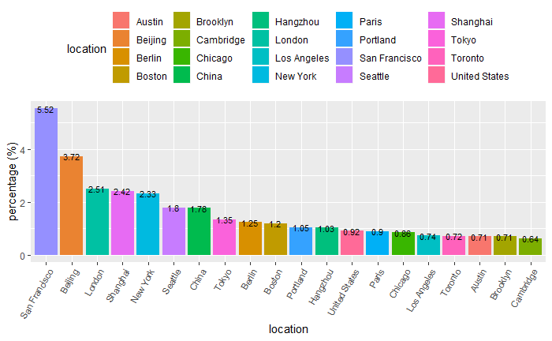

Slide 12
User Analysis
Who?
Extract users with introduction
Delete meaningless words
Count the frequency of words
Sort and Plot

Slide 13


Slide 15
User Analysis
Followers and Following
Clean Up data – NA / 0 cases
Outliers (93 % < 250)
Plot

Slide 16
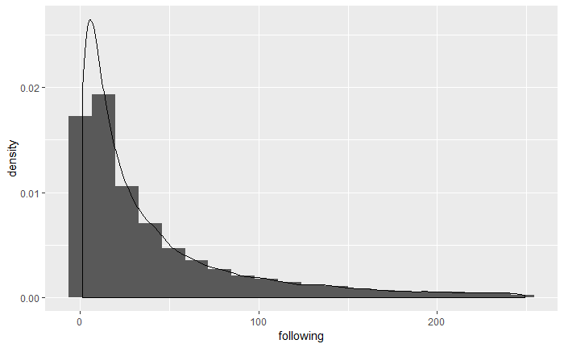

Slide 18
User Analysis
Not Finished Task:
Identify their company / institution / job
Relate users with their repositories

Slide 19
Repo Analysis
Languages
1. Count repos that has changed in a day by language
2. Compare popular language with history
Popularity Analysis
Open issues, forks, stars, subscribers
Notes:
Coming the repo analysis, one of the most interesting cut-in point is the languages.
We firstly find the mostly used language that most repos are using.
Then we compare this result with history records.
We can also find the fastest growing language.
We were are trying to do some popularity analysis on properties of a repo.
We only use data of one day in each year for the past 4 years so that
our database will not just get time out. As we said earlier, the amount of data was huge.

Slide 20
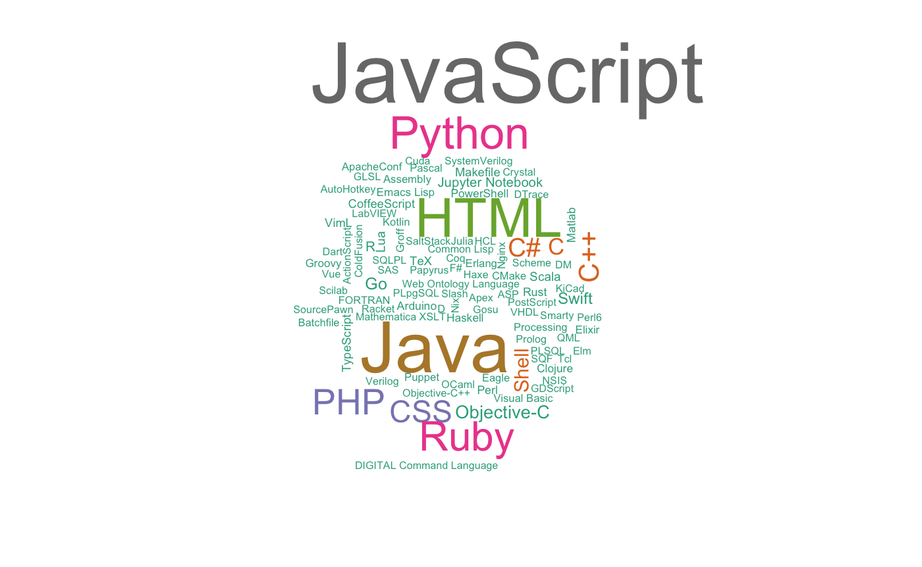
Notes:
Here is a word cloud for popular languages in 2016.

Slide 21
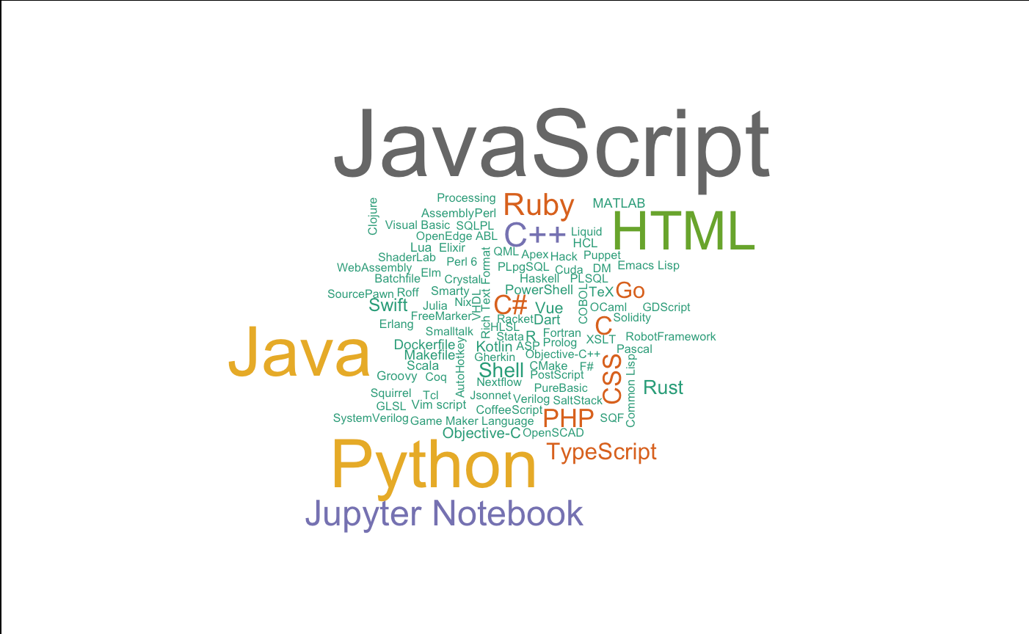
Notes:
Here is a word cloud for popular languages in 2019.
We can obviously see that Jupyter Notebook is becoming more and more popular.

Slide 22
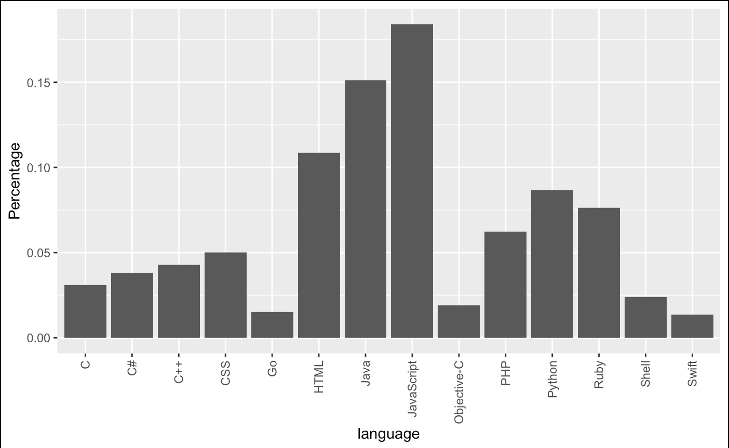
Notes:
This can be more clearly seen in charts.
Here is a proportion of repos of top languages in 2016.
At this time, Jupyter Notebook was not even considered.

Slide 23
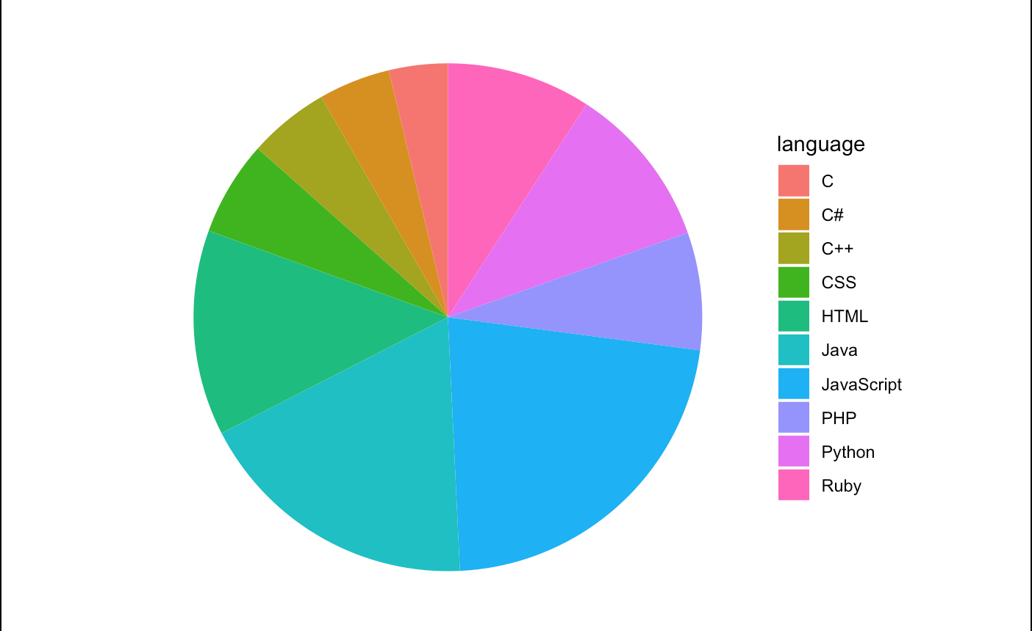
Notes:
2019-04-15

Slide 24
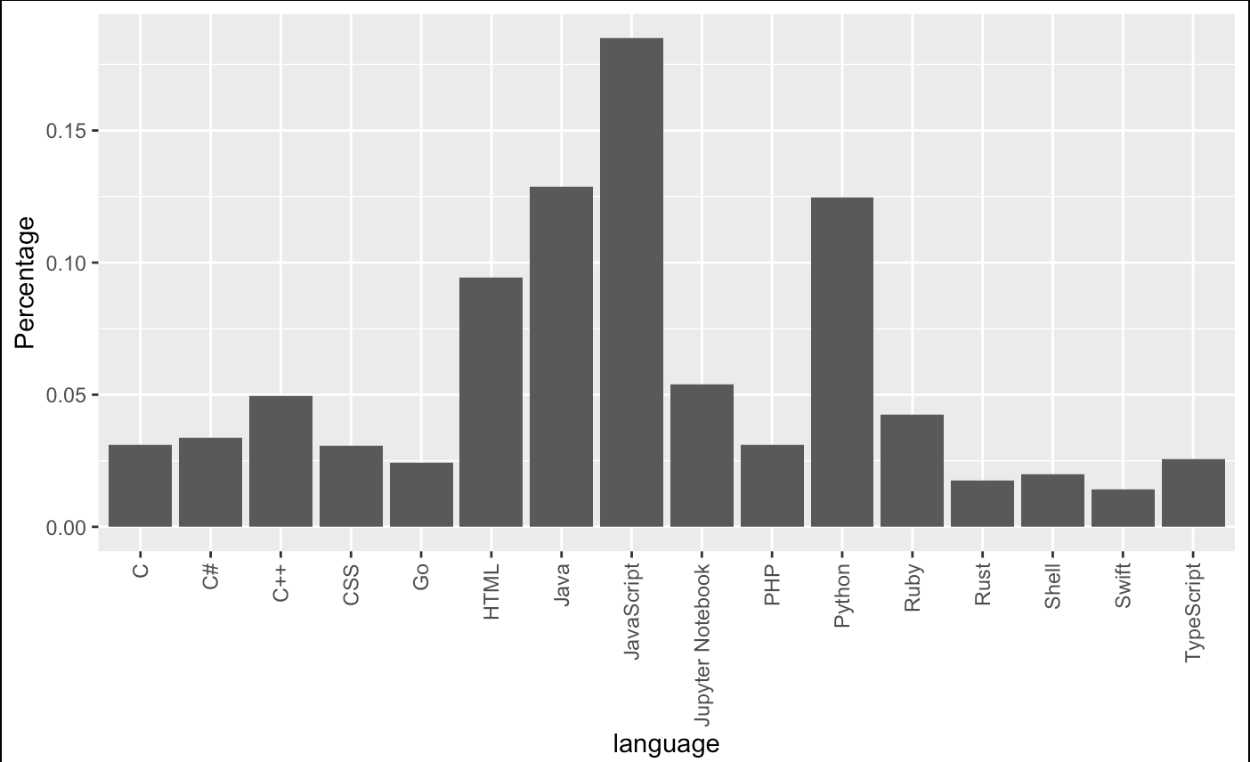
Notes:
However, in 2019, Jypyter Notebook has already climbed up to the 5th popular language.

Slide 25
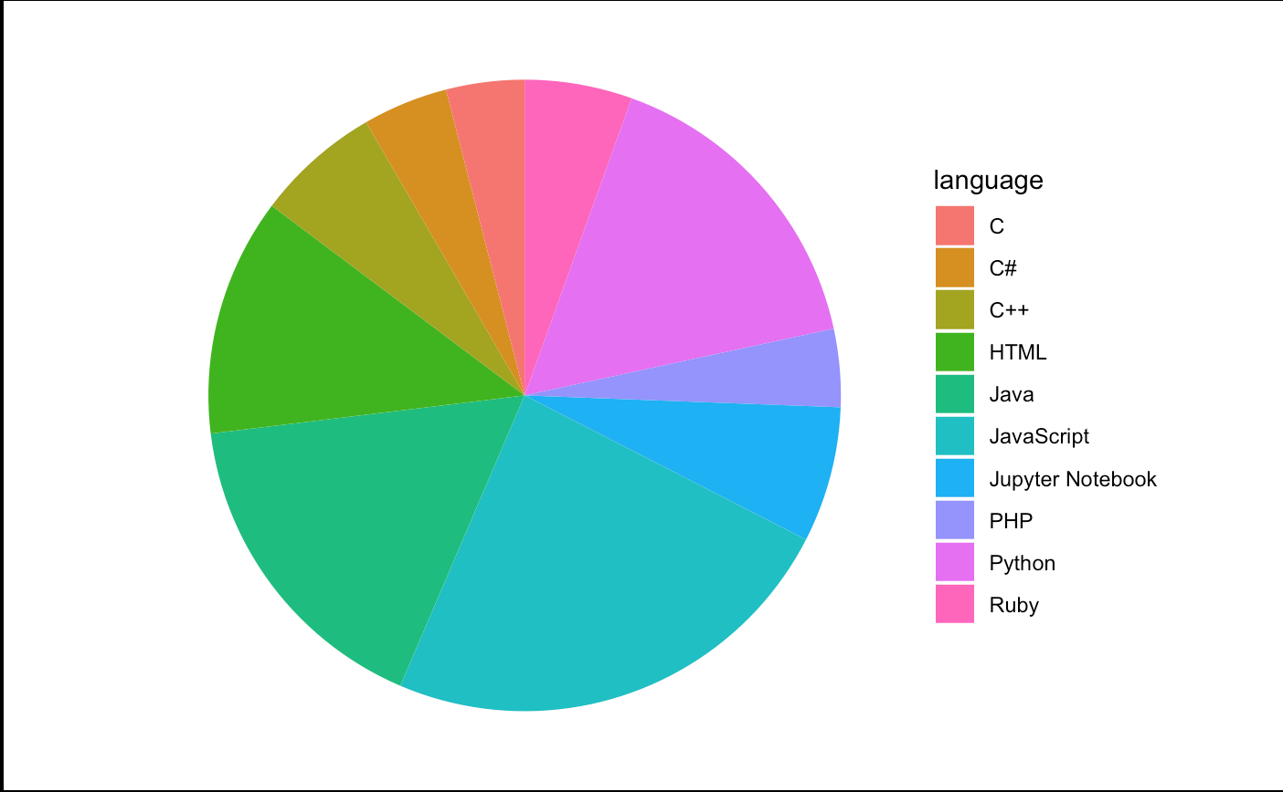
Notes:
2019-04-01

Slide 26
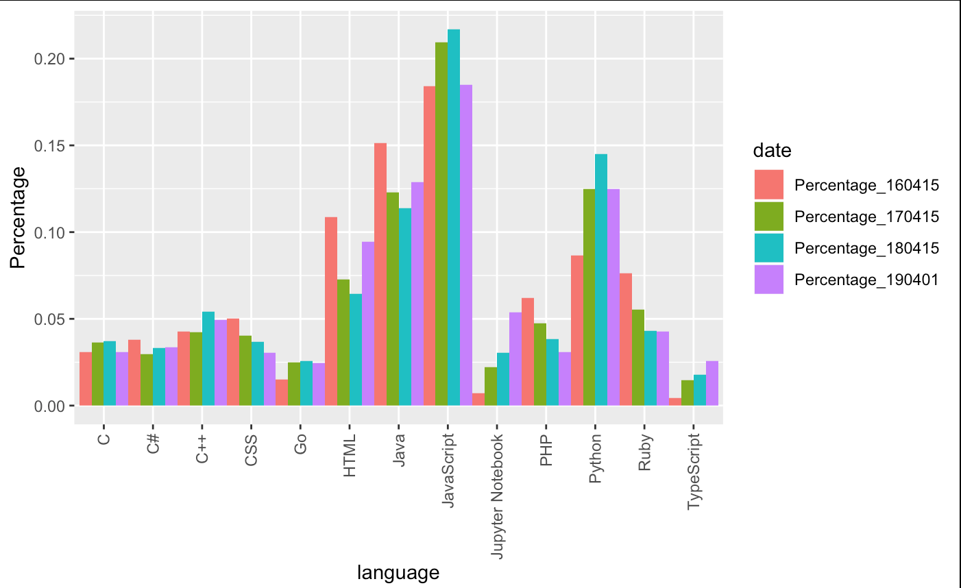
Notes:
Comparing data in the past 4 years, we can clearly see that there is
a high positive slop in Jupyter Notebook’s bars, while other languages are not in a obvious growing speed.

Slide 27
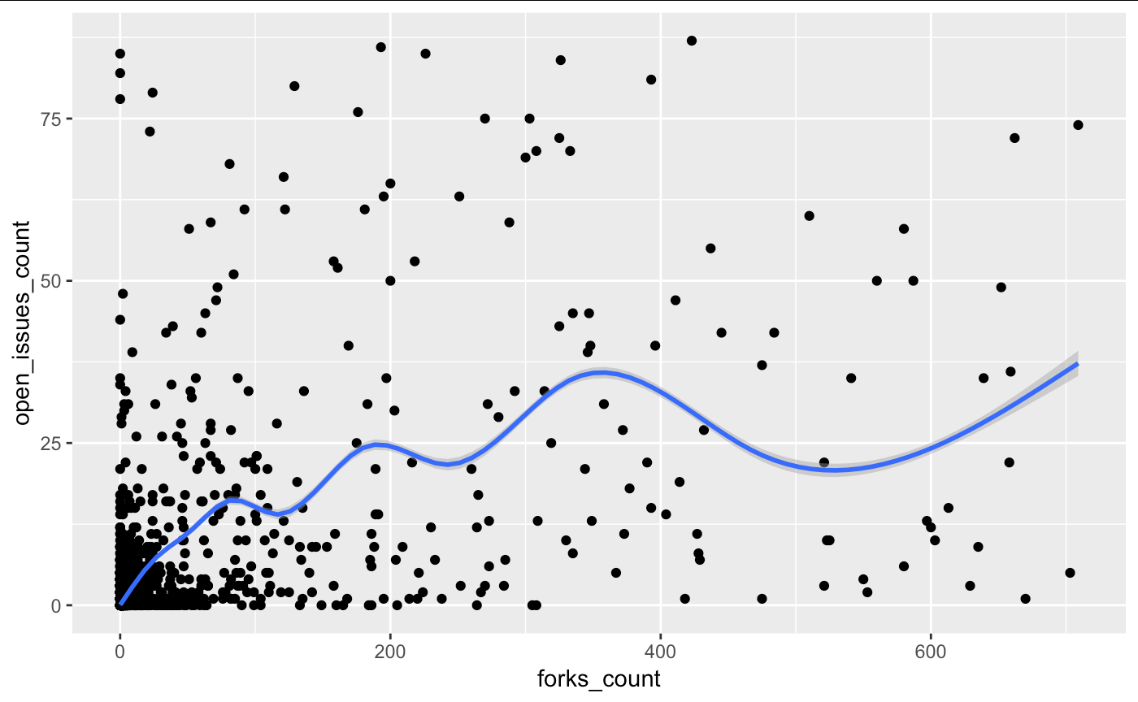
Notes:
We were trying to see if there is a relationship between properties of repos.
However, there may be not such a relationship.
Consider this graph, open issues v. forks. You cannot see if that here is something obvious.

Slide 28
Repo Analysis
To be finished
Relate with users, i.e. repo owner and contributors
Relate with commits
Notes:
Now, we still have works to do and currently we are working on
building a relationship between repos and users, so that we can track
if a popular user also have popular repos.
Another thing to do is to build a relationship with all commits.
Because commits part is way too large for our laptop to handle. we are facing a big problem here.
I hope at the end we can solve this.

Slide 29
Prediction
Based on properties of the owner of a repository, and his/her other repositories, predict the popularity of the repo.
Evaluate the popularity by a popularity index
Build a model on properties of a user
Predict using regression
Notes:
On to data predictions, what we are going to do is trying to predict
if a repo is popular based on who the owner of this repo is and the popularity of his/her other repos.
We are going to produce a popularity index to represent how popular a repos.
This popularity index should be able to be calculated by properties of a repo.

